Slide 1

FREEPORT, TX
SAFETY GLASS PRESENTATION
by
Dan Pennington
Chief of Police
Freeport, TX

Slide 2
SAFETY GLASS
Safety Glass (defined) – is glass with additional safety features that make it less likely to break, or less likely to pose a threat when broken.

Slide 3
TYPES OF SAFETY GLASS
3 Major kinds of safety glass:
  Tempered glass – glass processed by controlled thermal or chemical treatments to increase its strength. When broken, it crumbles into small granular chunks of similar size and shape instead of splintering into random, jagged shards.
    Examples – vehicle windows, shower glass, etc.
    History – dates back to the 1700s
    Advantages – less dangerous, 5-10 times stronger regular float glass
    Disadvantages – a break often causes entire glass to break; waves

Slide 4
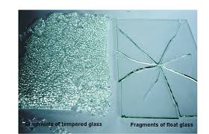
TEMPERED GLASS

Slide 5
TYPES OF SAFETY GLASS
  2. Laminated Glass - It is usually layers of toughened glass (polycarbonate or Lexan) and plastic or vinyl. Laminated glass holds together when shattered because, in the event of breaking, it is held in place by an interlayer between its two or more layers of glass.
    Examples – skylights, hurricane-resistant windows, aircraft windows, banks, car windshields, etc.
    History – invented in 1903
    Advantages – extremely strong (300x float glass), sound dampening
    Disadvantages – expensive and visual distortion

Slide 6
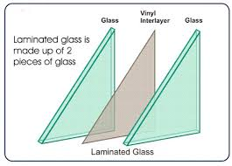
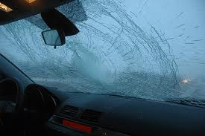
LAMINATED GLASS

Slide 7
TYPES OF SAFETY GLASS
    3. Wire Mesh Glass - wire mesh glass has a grid or mesh of thin metal wire embedded within the glass. Wired glass, as it is typically described, does not perform the function most individuals associate it with. Wired glass instead is utilized for its fire-resistant abilities, and is well-rated to both withstand heat and a hose stream.
    Examples – schools, hospitals, and hotels
    History – first use dates back to 1891
    Advantages – more likely to maintain partial integrity
    Disadvantages – weaker than regular glass

Slide 8
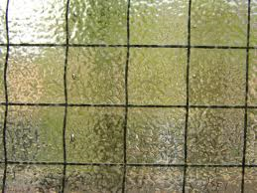
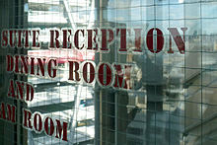
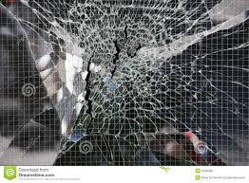
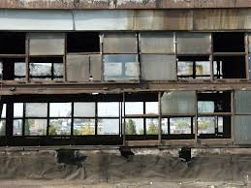
WIRE MESH GLASS

Slide 9
COSTS
On a scale of lowest to highest:
    Lowest cost is wire-mesh glass
    Medium cost is tempered glass
    Highest cost is laminated glass
Prices are very dependent on thickness, number of layers, etc.
      Float glass (tempered): $14 to $70 per square foot
      Laminated glass: $23 to $211 per square foot
      3. Wired mesh glass: $22 to $30 per square foot

Slide 10
VENDORS
4 major producers in the world
  NSG/Pilkington
  Saint-Gobain
  Asahi Glass
  Guardian Industries
Local Glass Dealers
  Precision Glass & Mirror - 713-534-7627
  A-Starbreak Auto Glass – 281-261-9333
  Alpha Auto Glass – 832-279-9439

Slide 11
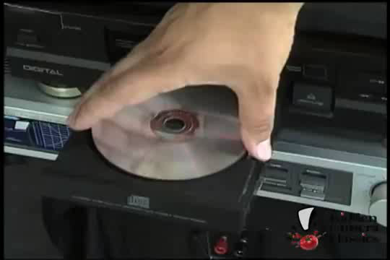

Slide 12
Conclusion
Questions & Answers
Dan Pennington dpennington@freeport.tx.us

