Slide 1
SAFES
FOR HOME AND OFFICE

Slide 2
Deputy
Jeremy Thomas
HARRIS COUNTY SHERIFF’S OFFICE

Slide 3
BROUGHT TO YOU BY:
SAFES FOR YOU
A FAMILY OWNED BUSINESS SINCE 2012

Slide 4
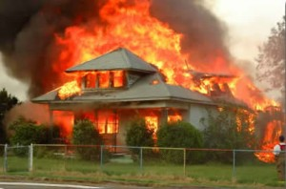

Slide 5
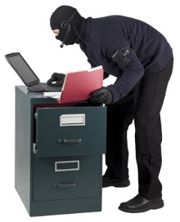

Slide 6
HOME SAFES
There are two types of safes for both home and business.
The first of these is a FIRE SAFE. This safe is designed to protect records from destruction by fire.
These safes are normally made with hollow walls and relatively thin steel.
They are filled with varying amounts of insulation and are easily broken with a burglars heavy tool or an ax.
It is not recommended to store valuables that are easily converted to cash or cash itself.

Slide 7
BASIC SENTRY HOME SAFE

Slide 8
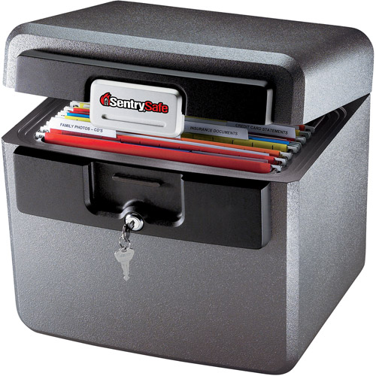
This model is sold at Wal-Mart for $58.79. It is the model HD4100. It is waterproof and fire resistant for 30 minutes and up to 1550 degrees F.

Slide 9
Provide high security protection for use in banks, jewelry stores and fire safe rooms in homes.
Complete with a Class B Mercantile Burglary rating, can be mounted in walls 7" - 18" thick
Carrying the UL Class 350 fire rating provides maximum security
Carry a 1 hour, 2 hour, 4 hour or 6 hour UL Rated Class 350 rating
Standard equipped with a Group 2 key-change combination lock and a UL certified re-locking device to set the bolts if the lock is punched in a tool attack or burglary attempt
Wide clear opening - stainless steel accessories - day gates
Made in USA
This next model is a Sentry SG2361 fireproof lock file and safe room door. It sells for $4,015 from Wayfair.com and includes free shipping.

Slide 10
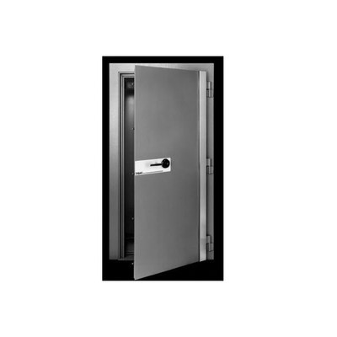

Slide 11
MONEY SAFES
The key feature of a money safe is its ability to resist burglary and robbery.
Burglary resistant safes are designed to withstand attacks by tools, torch or explosives in proportion to their construction specifications.
Robbery restrictive is designed to prevent thefts when there is no assault on the money itself.

Slide 12
Safe locks
Locking Dials
Lockable Handles
Lockable bolt control handles perform the
function as the lockable dials.
Time locks
Standard equipment on bank vault doors.
Ensures once closed and locks the safe or vault
door will remained closed for a pre-determined
amount of time.

Slide 13
Time delay combination
DAT or delayed action timer
Combination locks with one or more timer
movements attached
Operator must wait a pre-determined
period after dialing before the bolt can
retract.
Alarm combination
Incorporate micro-switches capable of
shunting alarms and signaling un-authorized
opening attempts.

Slide 14
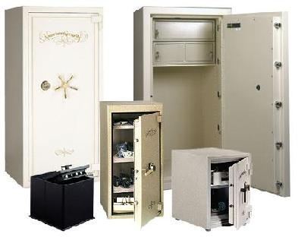
MONEY SAFES

Slide 15
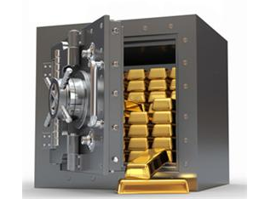
Warren’s safe on his yacht

Slide 16
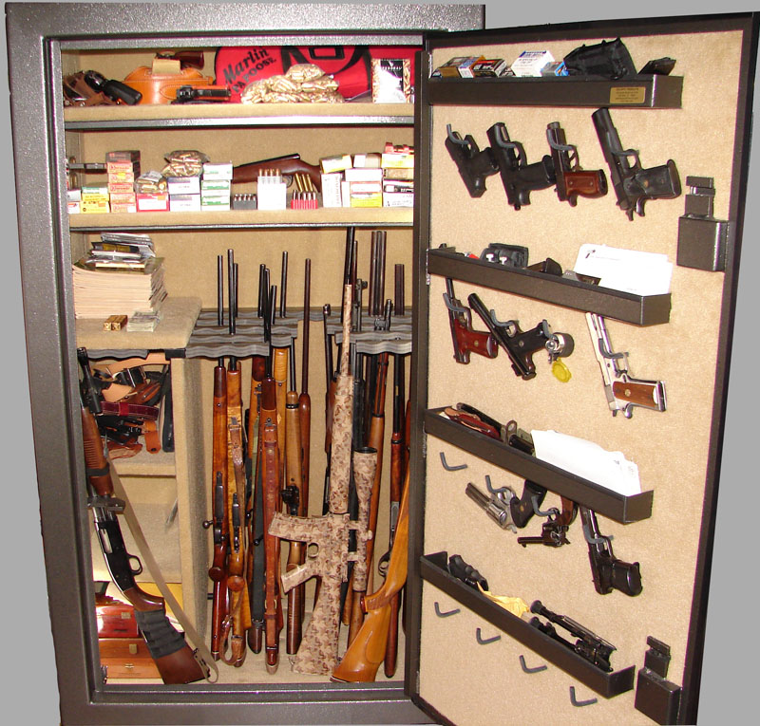
Browning fireproof gun safe

Slide 17
SAFE CONTACT INFORMATION
WWW.Sentrysafe.com
http://www.phoenixsafeusa.com/
www.browningsafes.com

Slide 18
QUESTIONS??

