Slide 1
Keyless Door Lock
Sgt. Dina Padovan
Notes:
How many people have a brand new home?
How many people live in a house that was previously lived in?
How many people live in an apartment

Slide 2
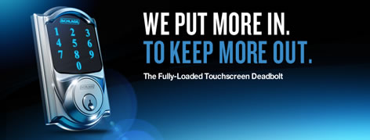
Notes:
Schlage Touchscreen deadbolt.
If your thinking about upgrading the security features in your home, the Schlage has a stylish look, comes in different colors.

Slide 3
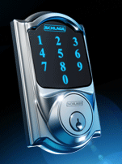
Benefits
A built-in alarm that sounds whenever the lock senses the slightest vibrations or movement of the door.
Serious strength, with the highest level of security and durability for residential door locks (ANSI Grade 1, as certified by BHMA).
Visual screen indicators that alert you when access is granted or denied, as well as when your digital deadbolt door lock batteries are getting low
A motorized, tapered bolt that automatically locks and unlocks when a correct code is entered.
Warning beeps that alert you when the deadbolt isn’t fully extended into the door jamb.
Notes:
Does your lock make the grade?
Schlage deadbolts have an ANSI Grade 1 security rating - this is the highest level of residential security available. American National Standards Institute (ANSI) is a private non-profit organization that administers and coordinates voluntary standardization to develop and maintain performance standards for builder's hardware.
Builders Hardware Manufacturers Association ((BHMA) Grading System is accredited by the (ANSI), a private non-profit organization that administers and coordinates the voluntary standardization to develop and maintain performance standards for builder's hardware.
The purpose of product grades is to help identify the quality and durability of locksets through a series of operational and security tests. Good, Better & Best
Grade 1 certification – Highest Grade Security. Grade 1 is the strongest grade ANSI/BHMA will supply for any Residential or Commercial product.
Grade 2 certification – Higher Residential Security. Grade 2 is designed and built to offer excellent security and durability for more residential applications and some light commercial applications.
Grade 3 certification – Basic residential security. Grade 3 is the lowest grade provided by ANSI, the minimal acceptable quality for residential door locks.

Slide 4
Benefits
No fumbling with keys as your approaching your front door.
Don’t have to carry your keys if you need to run to the mailbox or going for a walk.
Let your guest in without leaving a key.
Loss of keys
Don’t have to worry about having lock picked, bumped or manipulated
Don’t have to worry about changing your locks.
Notes:
Benefits why you should have the keyless door lock

Slide 5
Internet connectivity
You can also set the system to send a text or email alert if the alarm is triggered or if a user makes too many incorrect attempts at the pin pad.
This is useful if you are not home, but still want to be able to alert the authorities if someone tries to gain unauthorized entry to your home.
Notes:
Can log in from your computer of phone.
There is an additional cost to the lock for the Nexia monitoring which is a monthly fee.

Slide 6
Installation
It's more or less the same as any other deadbolt. There's no need to do any wiring so all you'll need is a few basic tools, a screwdriver being the most important.
Notes:
Come with instructions, that reviewers said it only took 30 mins to install.

Slide 7
Ratings
C|net rated the Schlage
    High Quality but be sure to compare to other keyless locks.
Home Depot
Innovative Technology when it some to security
Lowes
Elegant Modern look with excellent security features.
Notes:
People want to always go with high end washer & dyer or a flashy fridge. Why not go with high end door lock.

Slide 8
Where can I purchase the Schlage
Amazon
Home Depot
Lowes
Notes:
Do not carry in the store. Or online/in store

Slide 9
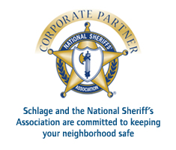
Supported by

Slide 10
Sergeant Dina Padovan
713-743-0596
dpadovan@central.uh.edu

