Slide 1
CRIME PREVENTION II
BUSINESS CRIME PREVENTION SURVEY
COMMERCIAL SECURITY

Slide 2

Presenters
Sgt. P. Englishbee
Missouri City Police Department

Slide 3

Officer Willie Williams
Texas Southern University Police Department.

Slide 4

Deputy William Hart
Harris County Sheriff’s Office

Slide 5

Deputy Jeremy Thomas
Harris County Sheriff’s Office

Slide 6
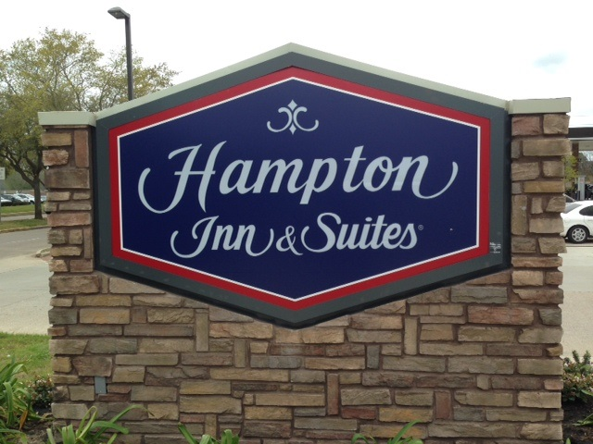
4909 HIGHWAY 6

Slide 7
EXTERNAL ENVIRONMENT
The business is a new construction hotel that is located at 4909 Highway Six. The business is actually located off of Highway Six and behind a gas station that blocks its view from the main road.
Entry is made off of Colonial Lakes Drive and there is a small driveway that travels north and south from Colonial Lakes Drive on the north to Dulles Avenue on the south. There is an empty field located on the north side of the property.

Slide 8
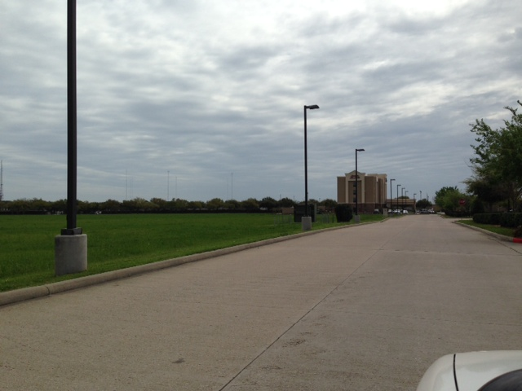
VIEW FROM THE SOUTH

Slide 9
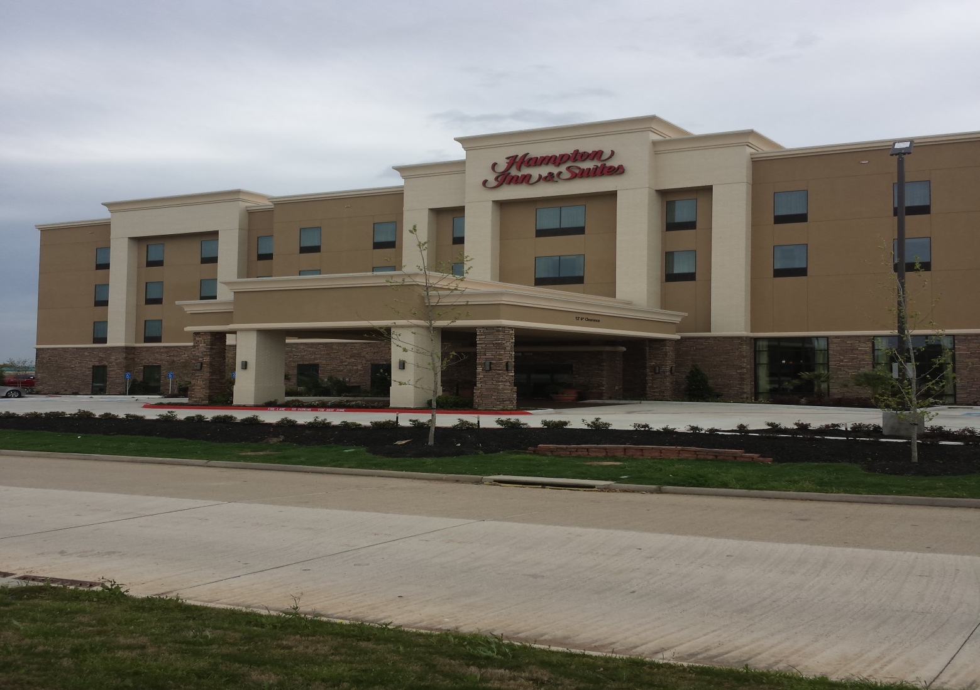
FRONT OF HOTEL FROM DRIVEWAY

Slide 10
EXTERNAL ENVIRONMENT
Traffic on Highway Six can be described as moderate to heavy. Highway Six is also a State of Texas planned evacuation route. Traffic on Colonial Lakes Drive is described as light to moderate depending on the time of day. Traffic that travels in the driveway, in front of the hotel is light.
EVACUATION:
SH 6 @ Colonial Lakes. Set traffic signal to flash mode with yellow flash for SH 6 northbound traffic and red flash in all other directions.
Barricade Colonial Lakes @ SH 6.
Provide manual traffic direction, as situation requires.
Monitor traffic and ensure a smooth SH 6 northbound

Slide 11
EVACUATION ROUTE

Slide 12
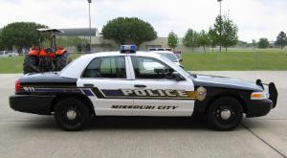

LAW ENFORCEMENT
The Missouri City Police Department is located approximately 3/10th of a mile by driving and has had little call volume at this location since it was constructed.

Slide 13
EXTERIOR LIGHTING AND OTHER
The exterior lighting at this location is a combination of Halogen and LED lighting. The lighting on the building is unobscured and creates a good lighting environment at night.
The lighting on the building itself also shines as appropriate to reduce any areas of darkness.
The trees and shrubs are newly planted and do not obscure vision either from the road or from the inside of the hotel. Staff should be cautioned to be aware of this in the future as the trees and shrubs mature.
Due to the nature of the business there are no external alarms.

Slide 14
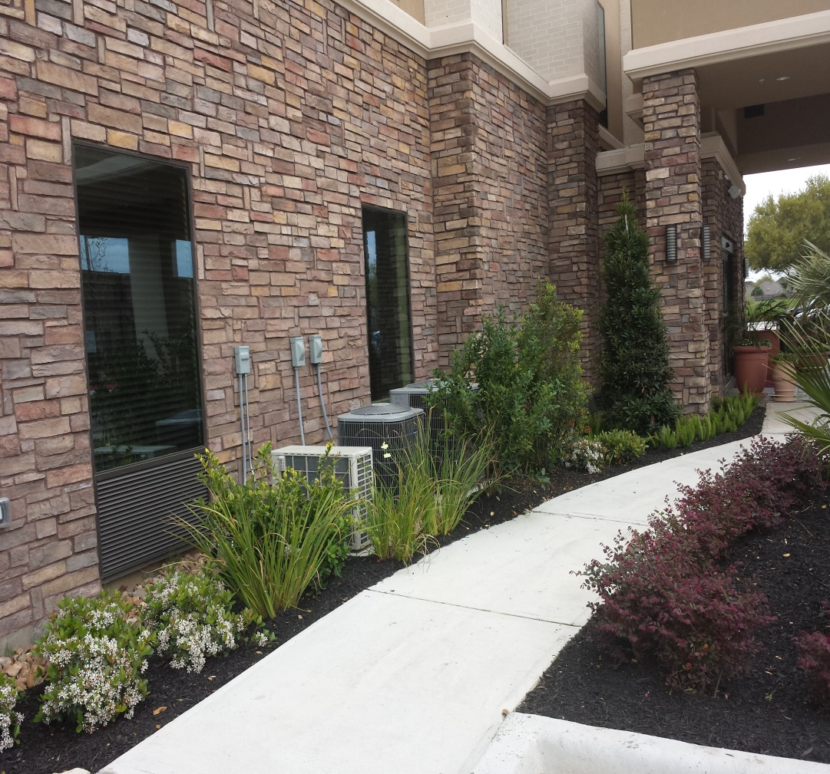
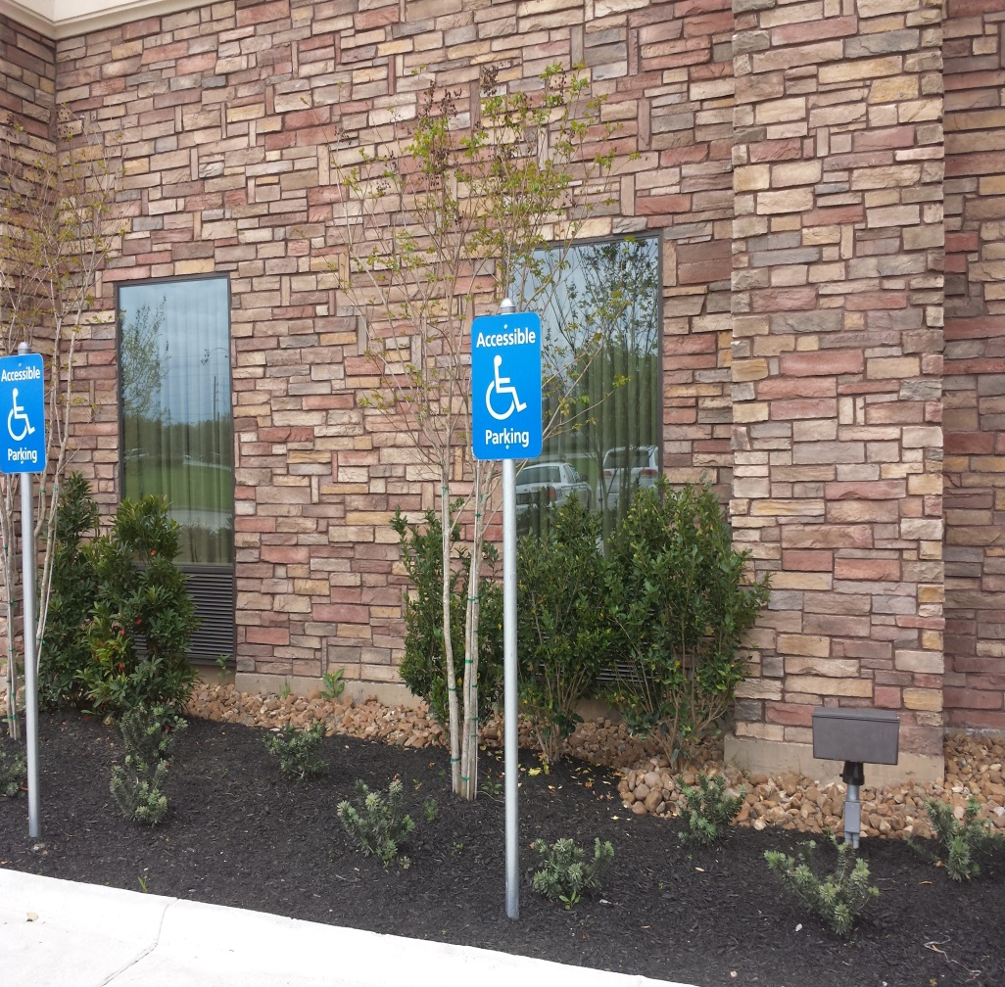
EXTERNAL SHRUBS AND TREES

Slide 15
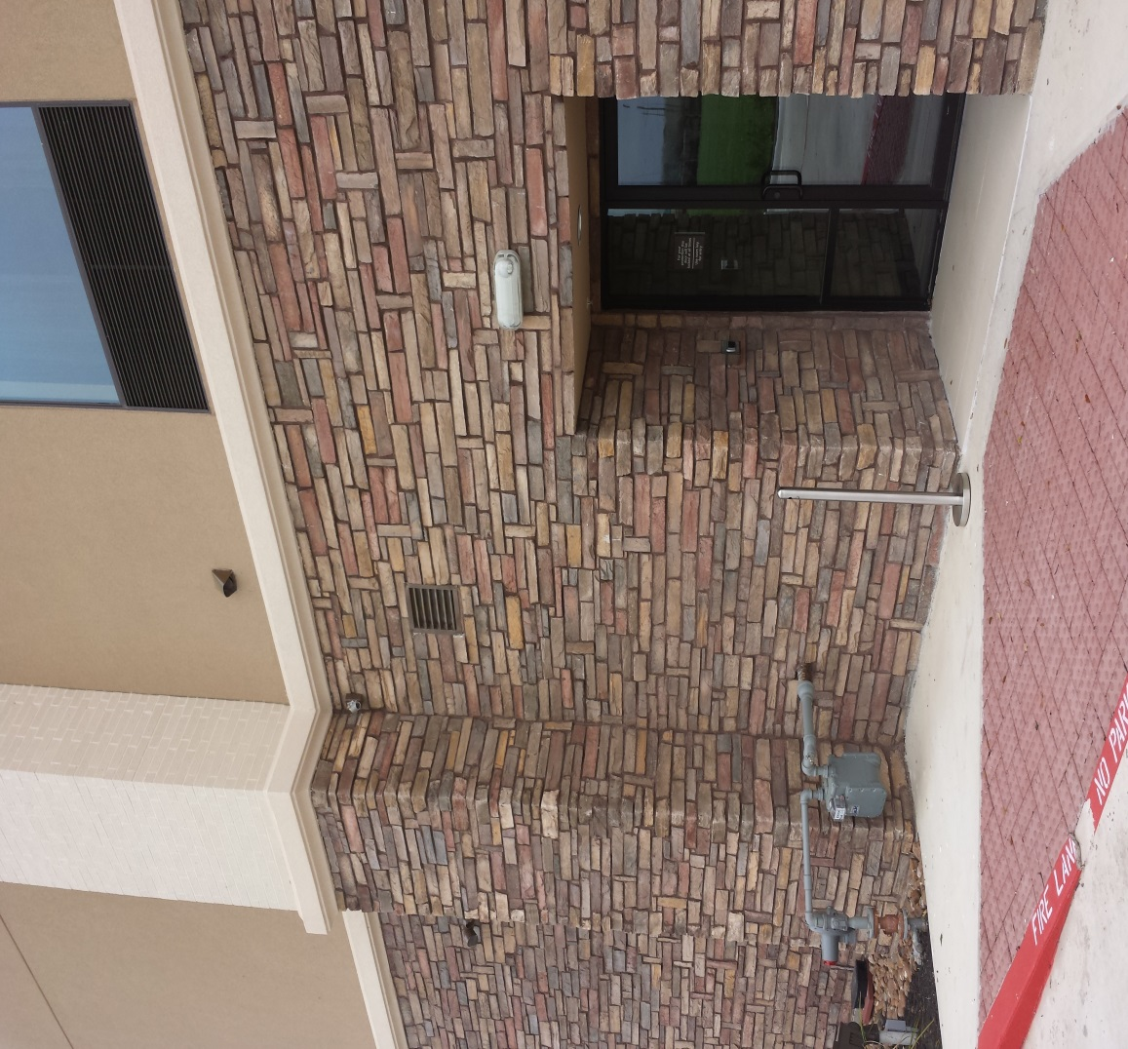
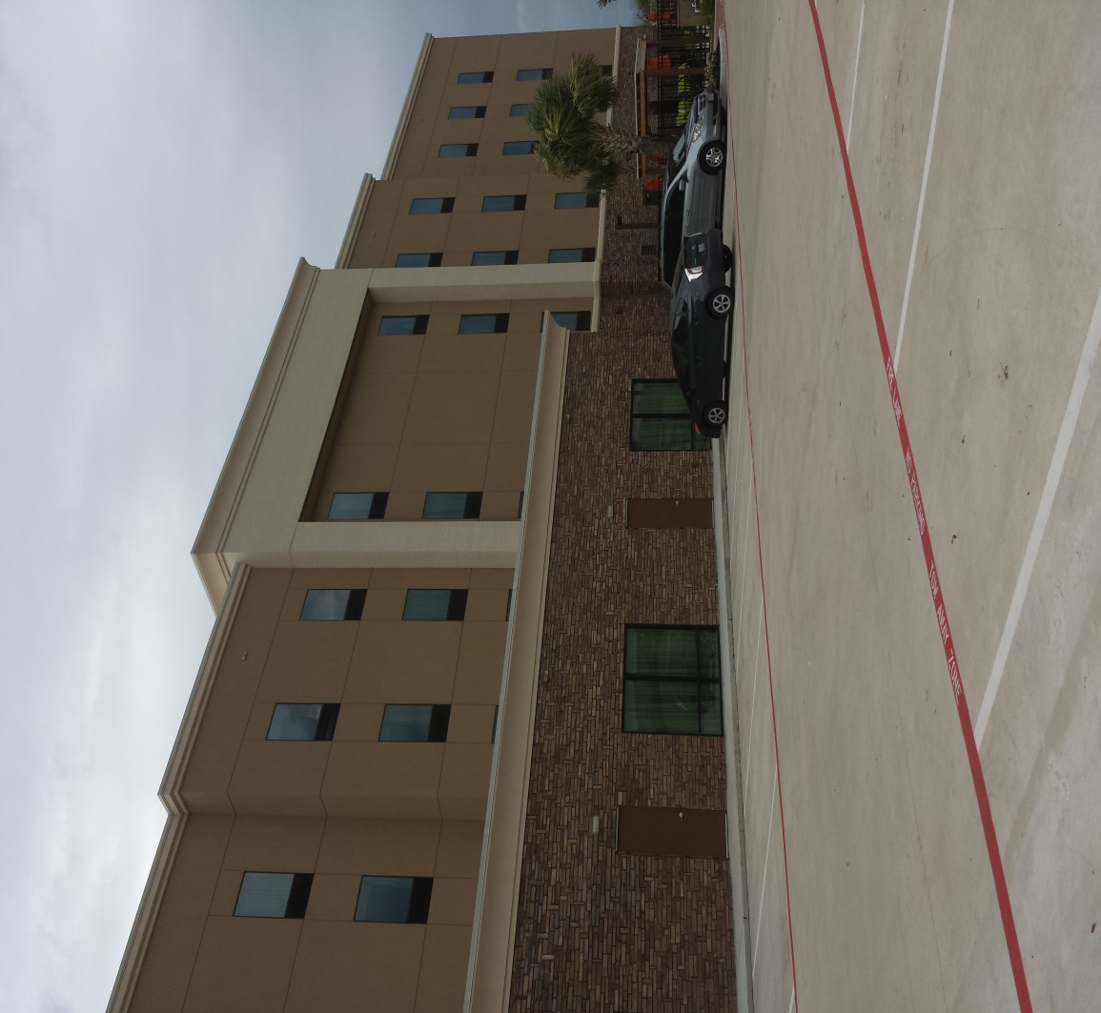
EXTERNAL DAYLIGHT LIGHTING AND CAMERAS

Slide 16
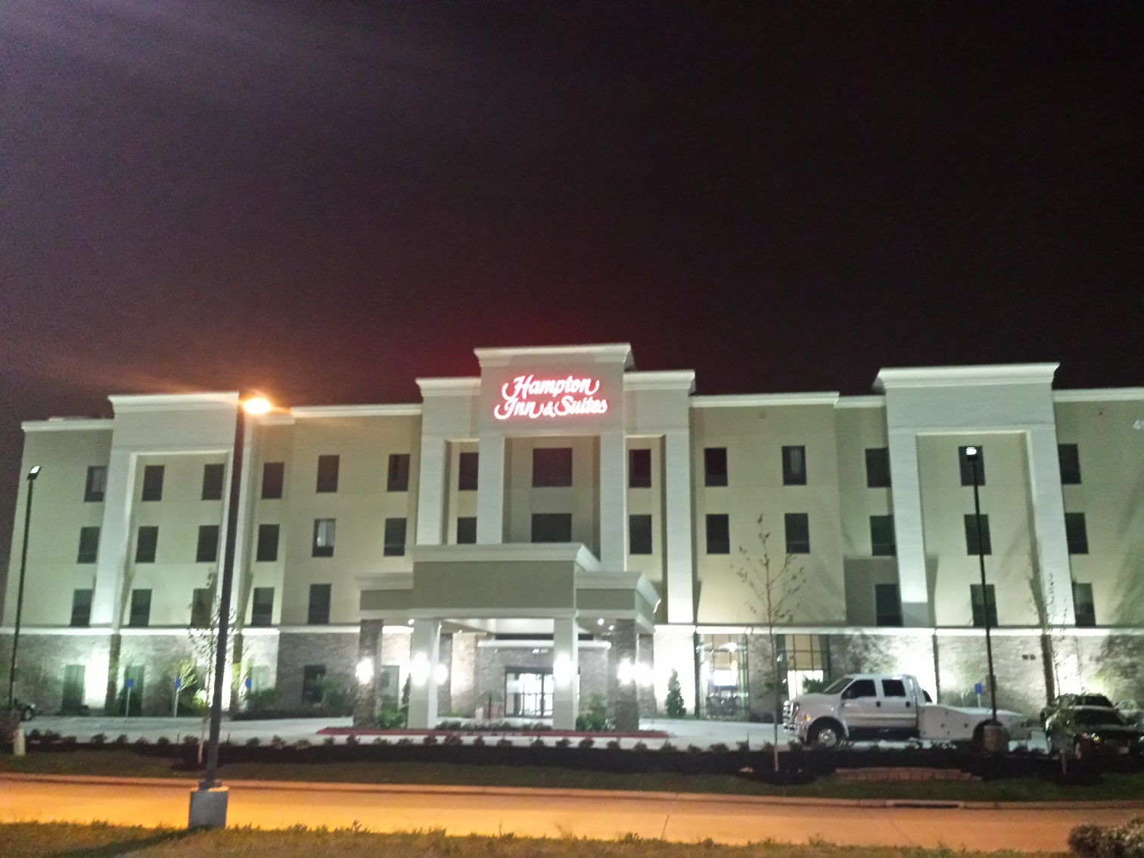
FRONT AT NIGHT

Slide 17
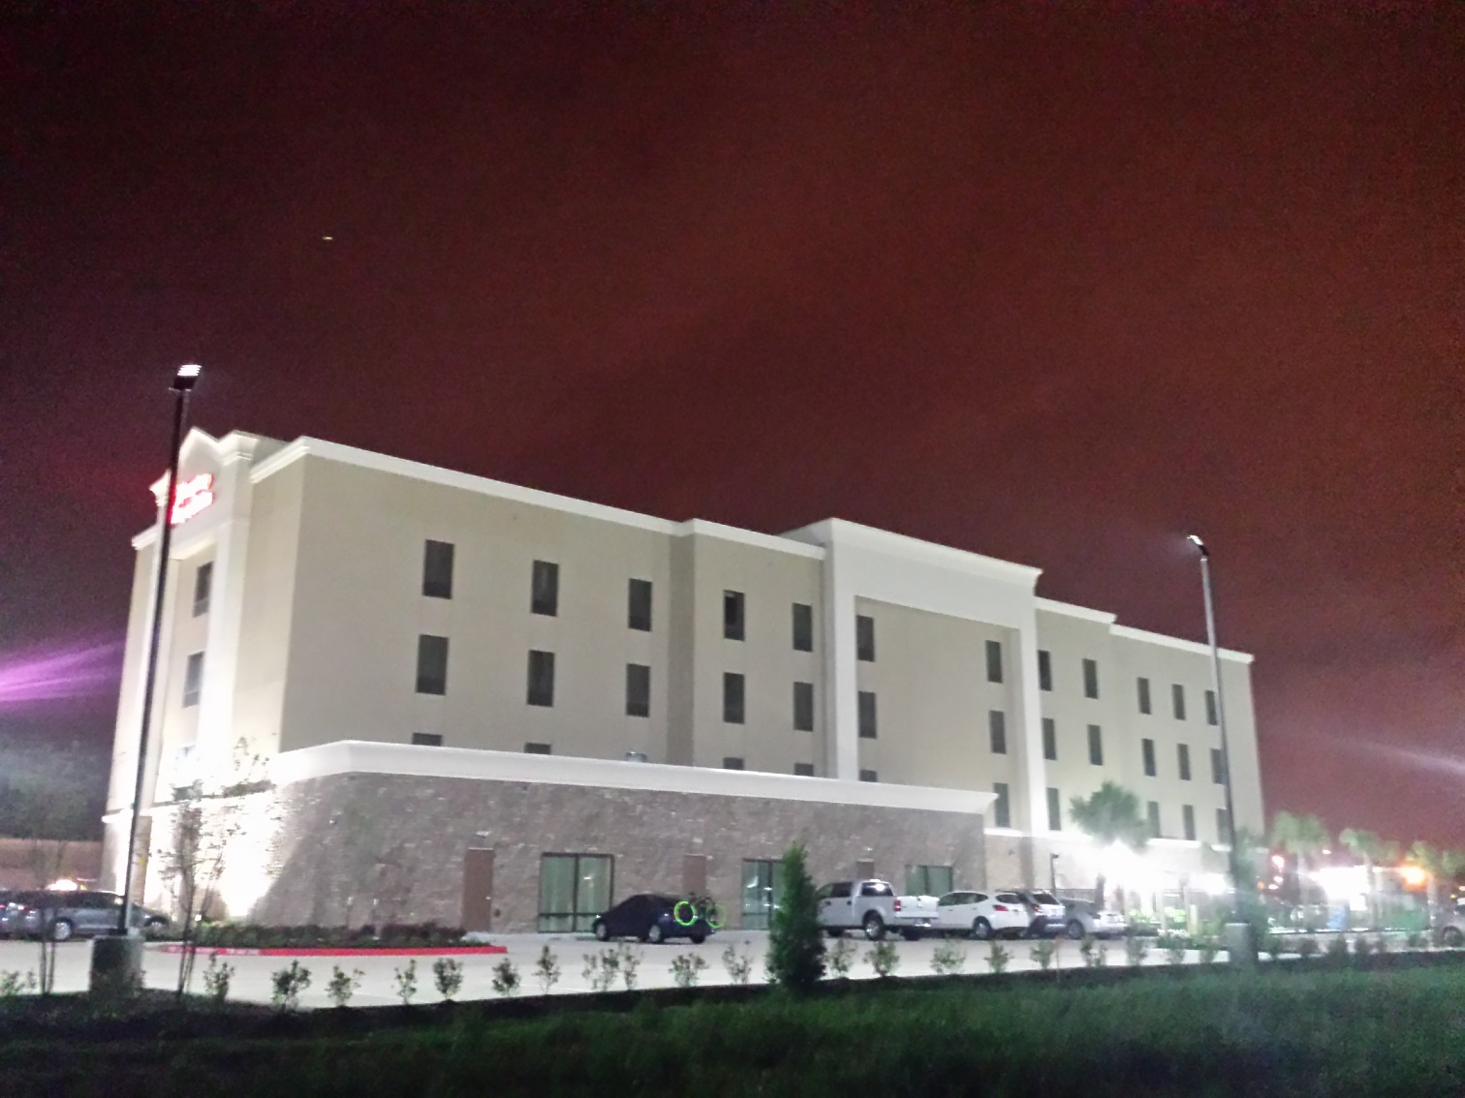
BACK OF HOTEL AT NIGHT

Slide 18
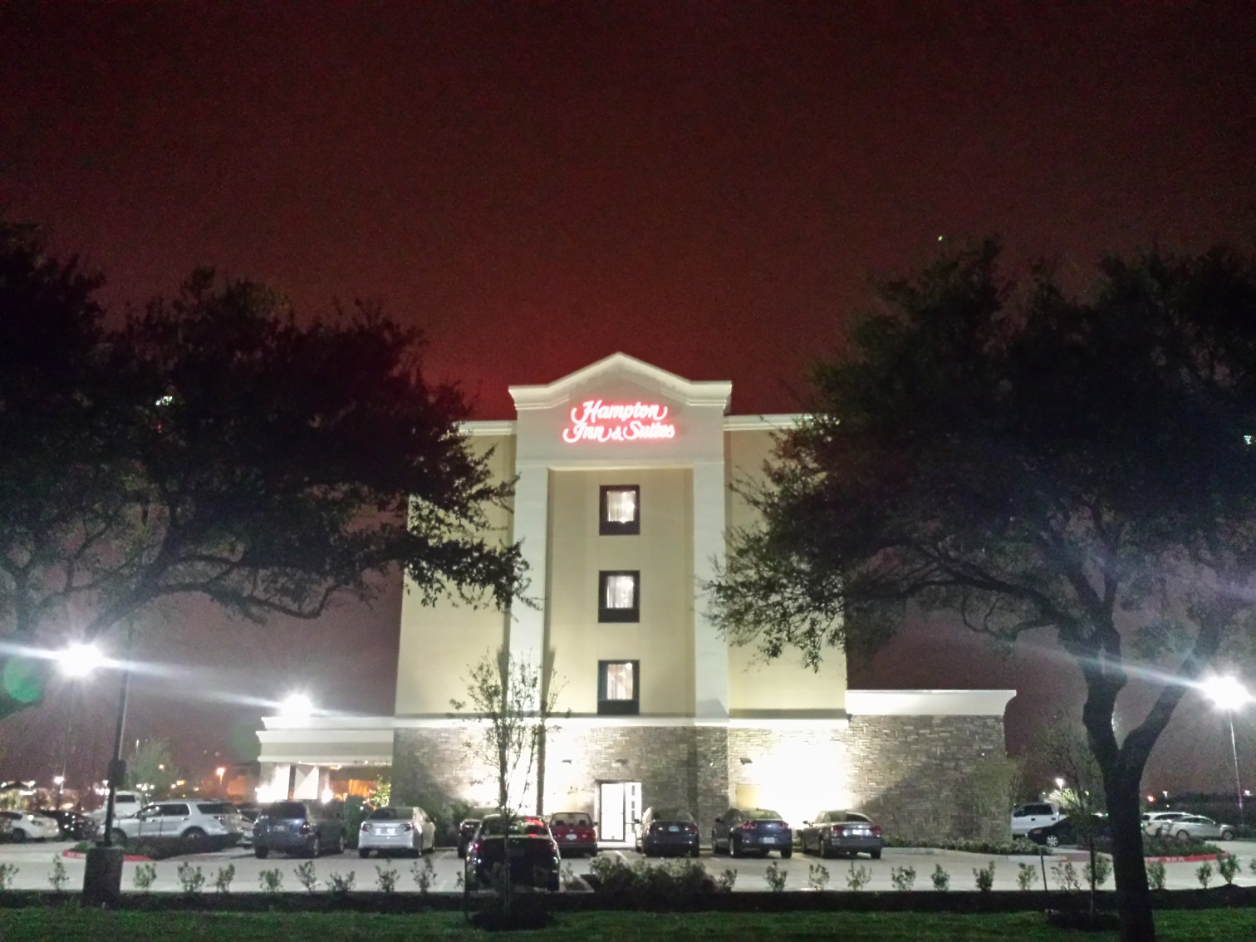
SIDE DOOR AND PARKING LOT

Slide 19
DOORS
The front door is located on the east side of the building. It is a motion activated, sliding glass door with a metal frame. The motion is activated from approximately 6 feet away.
The motion activated opening is disabled during nighttime hours, from 2200 hours to 0600 hours and it is manual entry, with a key card.

Slide 20
DOORS
There is an entry exit door located on the north, south and south east corners of the building. These doors are only opened from the outside with a key card and opened from the inside with a push bar as required by code. Internal doors to the various rooms are solid doors that entry is made by sliding a key card in.
There is a key fob that the staff can check out to make entry into the rooms but it is controlled by management.

Slide 21
DOORS
The roof is accessed by a supply room located on the top floor. The room is locked from the outside and there is a fixed ladder inside the room to allow access.
There is a door at the top of the ladder that allows access to the roof. There is a latch system in place however, the latch itself is not locked by an external lock.

Slide 22
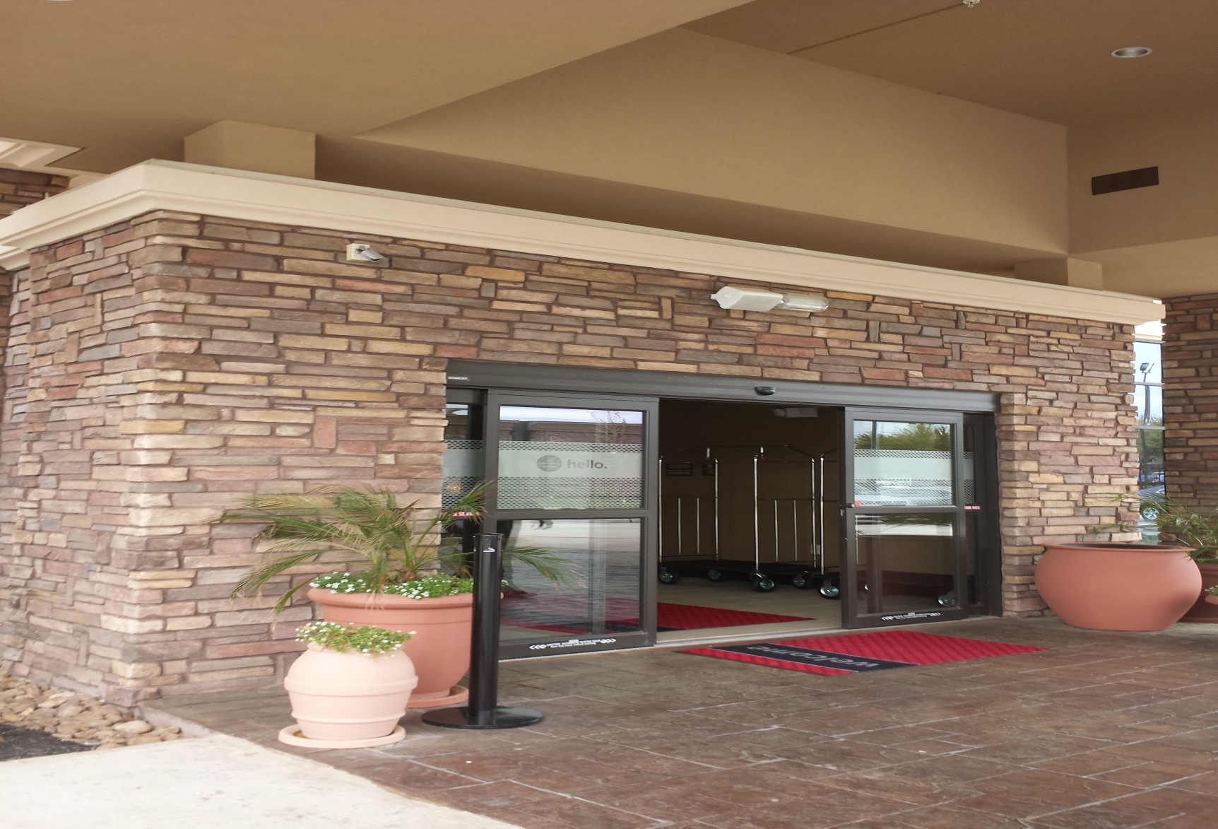
FRONT DOOR OPEN

Slide 23
SAFES
There are two safes in the building. Both are located in the central supply room, behind the front desk. There is a floor safe that only management has access to that is used for the business.
The second safe is a three drawer safe that is used by the employee’s for storing tips, and other monies received from guests.

Slide 24
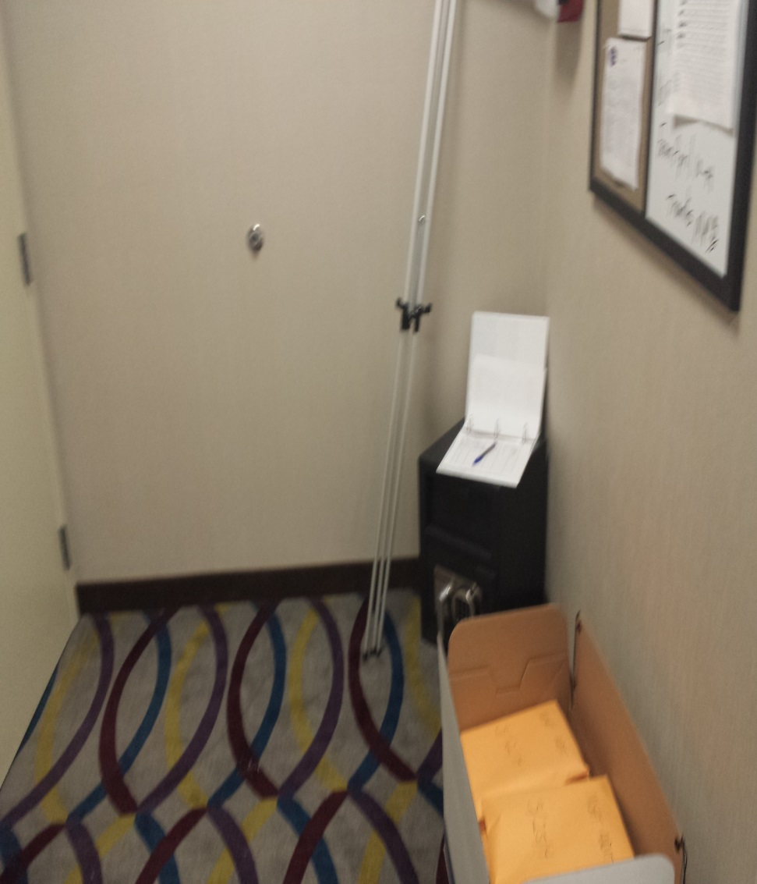
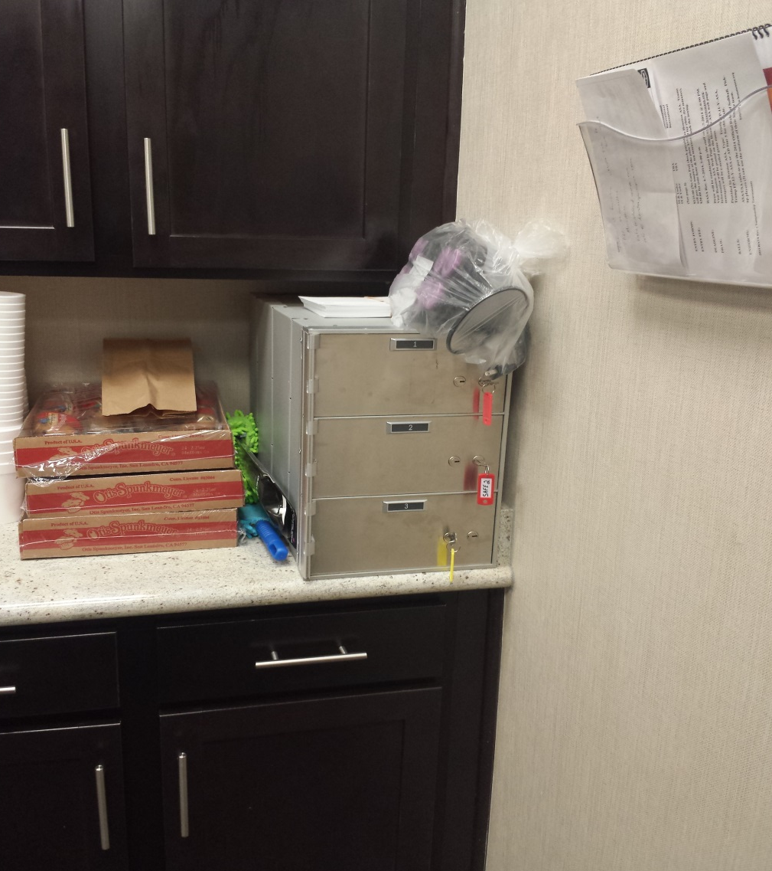
SAFES

Slide 25
WINDOWS
All of the windows in the building were standard, commercial grade plate-glass of varying sizes.
All of the windows were fixed, with no locks needed and attached to aluminum frames.
The main recommendation regarding the windows is that they be kept free of debris both inside and outside of the building.

Slide 26
ALARM AND CCTV
The hotel does not have any perimeter or exterior alarms, nor are their any panic alarms located in the hotel. The only alarm that is currently in place is a standard fire alarm with a company that offers 24 hour monitoring from out of state.
It is recommended that a panic alarm be installed both at the front desk and the management office.

Slide 27
ALARM AND CCTV
There is a closed circuit television system installed throughout the hotel. There are interior and exterior cameras, as well as, cameras located on every floor. There was no camera observed in the fitness room nor in the small area where supplies and snacks are sold.
Only the management can make copies of the recorded events. There are no zoom capabilities on the system while recording.

Slide 28
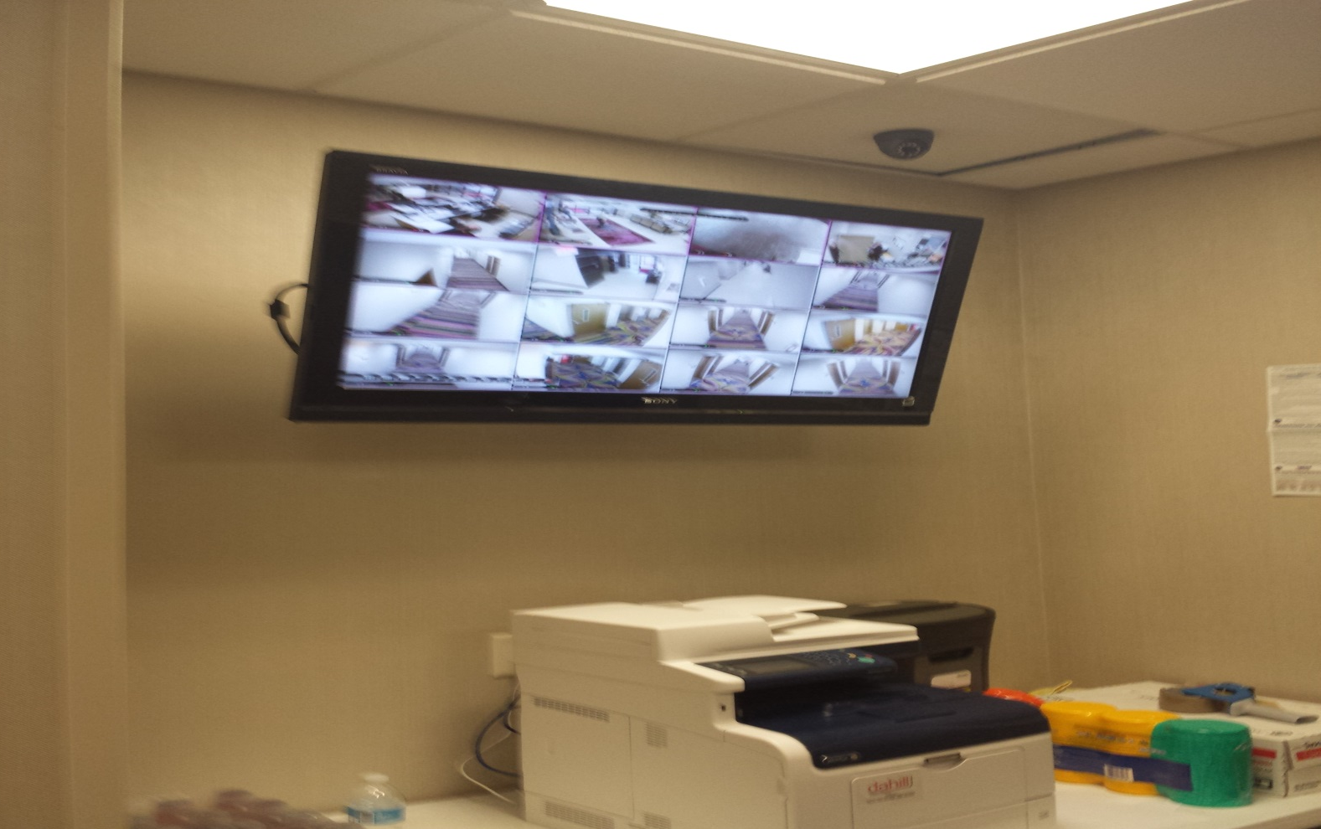
LIVE MONITOR IN MANAGEMENT OFFICE

Slide 29
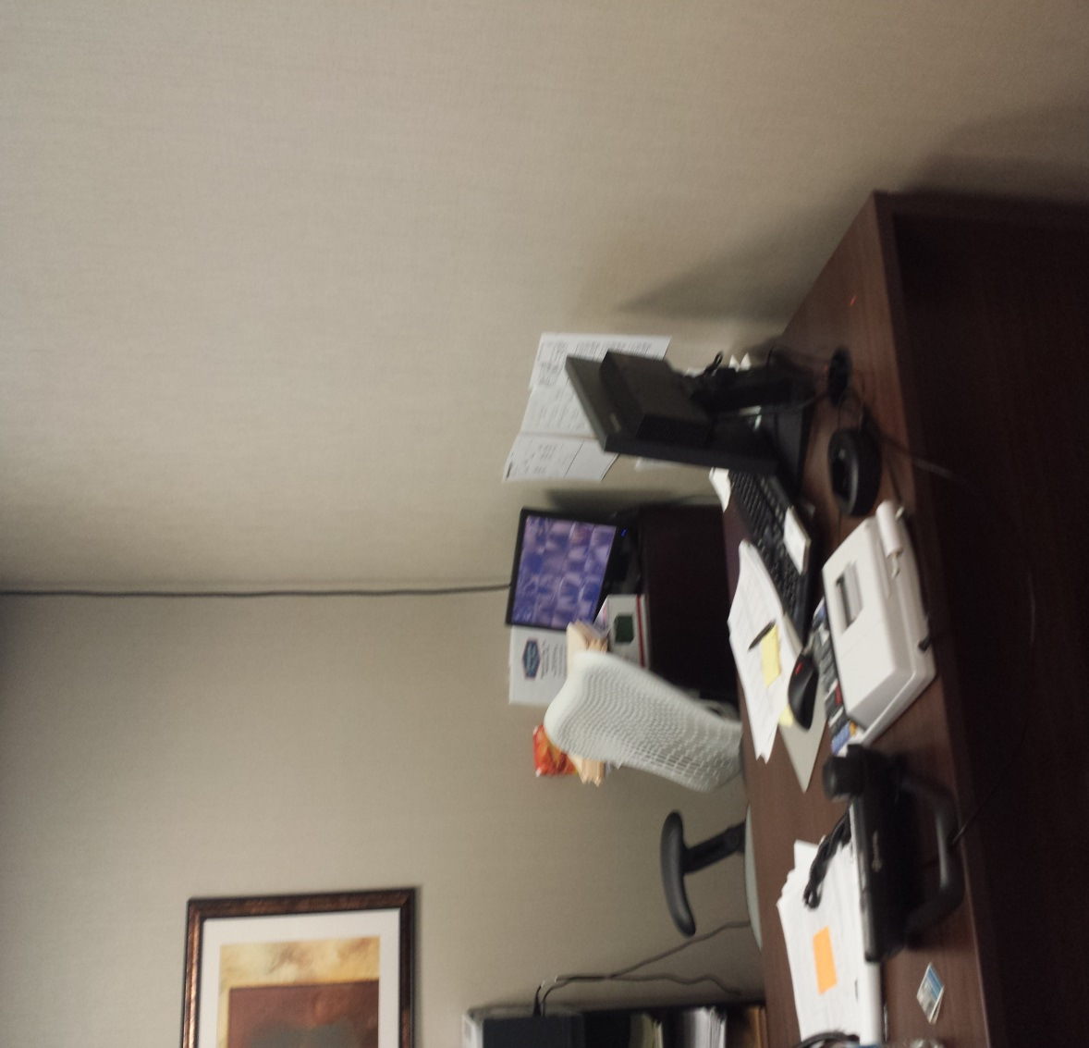
SMALL MONITOR IN GENERAL MANAGERS OFFICE

Slide 30
FLOORS IN THE LOBBY
The floor in the building is a combination of tile and carpet which has been inlayed into the tile.
Even though the building is relatively new the carpet is starting to become frayed on the corners and could become a hazard for pedestrian traffic.
It is recommended that the carpet be constantly checked for safety. A maximum recommendation would be to remove the carpet and replace with tile.

Slide 31
DELIVERY AND INVENTORY CONTROL
All deliveries are made through the front door and only on Tuesday and Thursdays.
The normal hours for delivery are between 1100 and 1300 hours.
Employees are required to escort all delivery drivers when they are in the building.

Slide 32
OVERALL BUILDING SECURITY
Overall the building in in good repair and safety appears to be a priority for the management.
The new construction is possibly a factor in the positive safety issues.
The management appears to be concerned with both the safety and security of it’s guests and employees.
Some of the issues with the building would be the roof access being locked.

Slide 33
OVERALL BUILDING SECURITY
The main issues with the security of this building would be the lack of an alarm system for anything other than fire response.
A panic button located both at the front desk and the General Manager’s Office would be an important recommendation that would improve the the security of the staff.

Slide 34
QUESTIONS?

